Slide 1
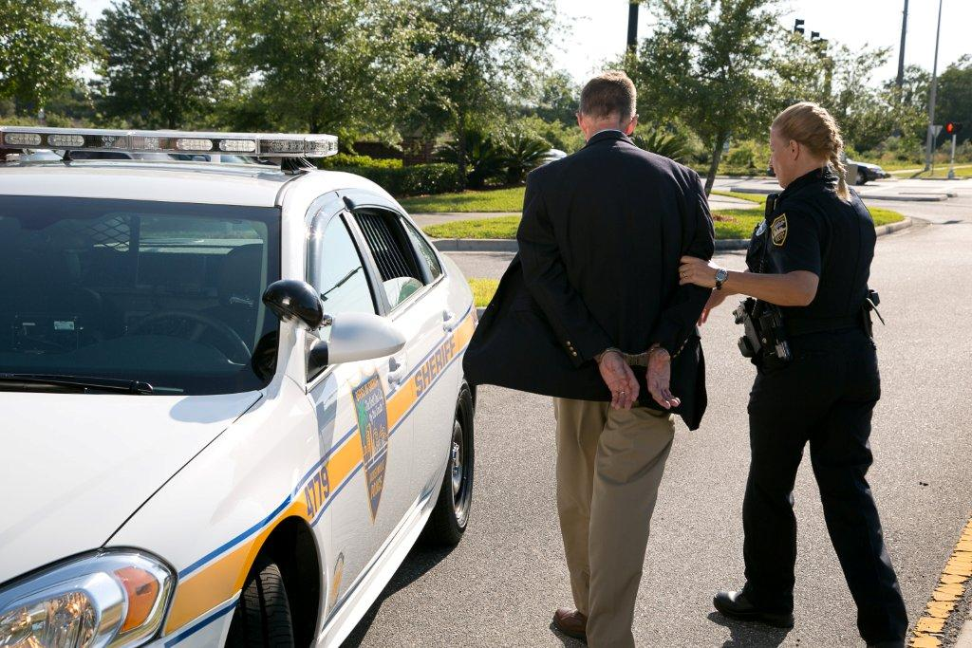
Session 11
Processing the Arrested Subject, Report Writing, and Preparation for Trial

Slide 2
Learning Objectives
Discuss importance of correct processing and report writing procedures in DUI arrests
Discuss correct sequence of DUI processing procedures

Slide 3
Learning Objectives
Discuss the essential elements of a DUI report
Successfully complete a narrative arrest report
Discuss the importance of trial preparation

Slide 4
Foundation for Successful Testimony
Relationship between law enforcement officer(s) involved with arrest and prosecuting attorney(s)
Effective communication and a clear understanding

Slide 5
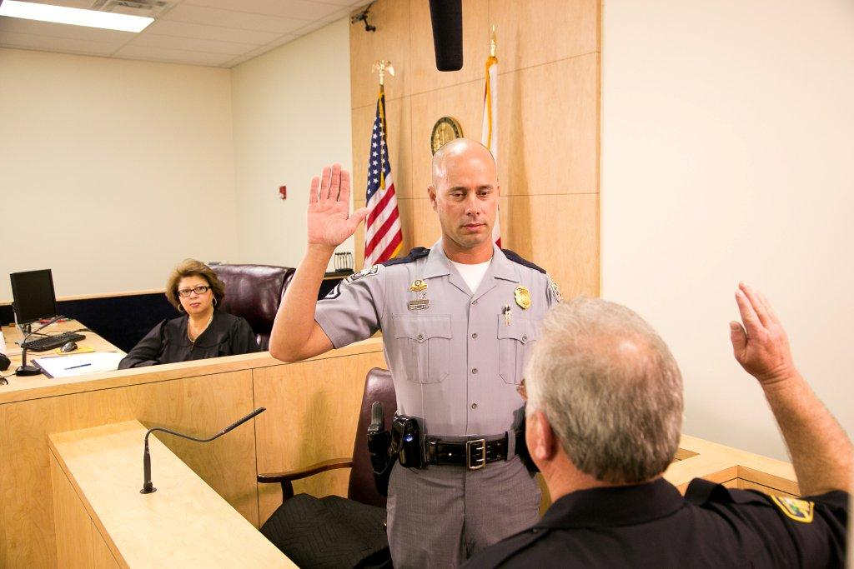
Testimony
Be prepared to speak to the evidence
Take time (Pause & Answer)
Listen
Organize response before answering questions

Slide 6
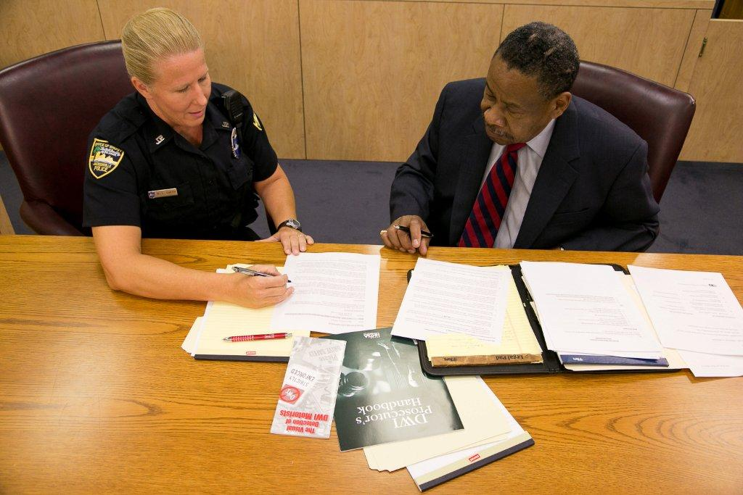
Successful Prosecution
Organize and present relevant evidence
All evidence must be compiled and documented during three phases of detection

Slide 7
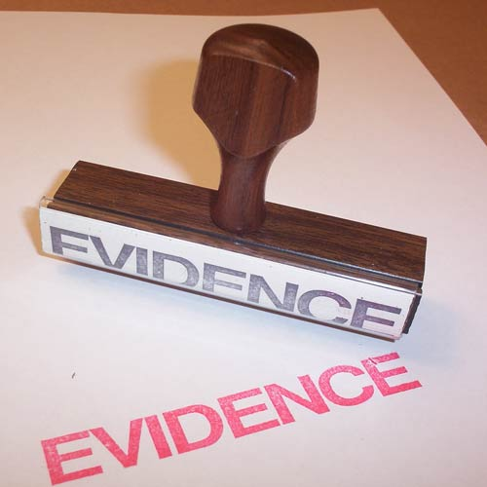
Types of Evidence
Physical
Established facts
Illustrative
Demonstrative
Written documentation
Testimony

Slide 8
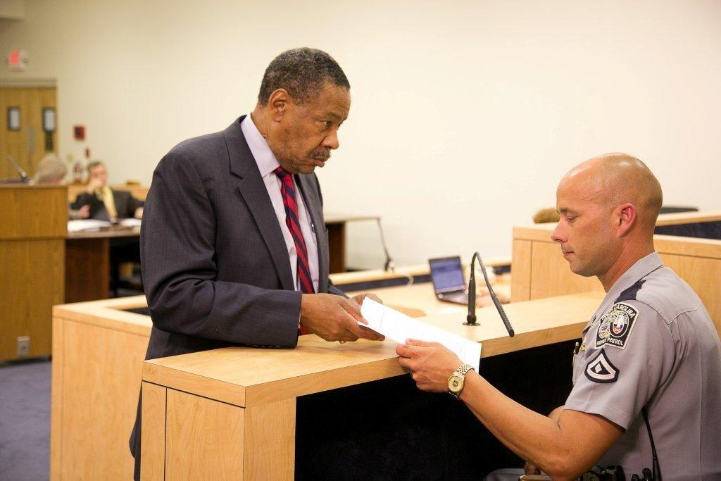
Prosecutor
Prove every element of offense
Establish proper procedures were followed
Admits exhibits into evidence

Slide 9
Proper Arrest Procedures
Arrest Advisement
Securing Defendant/Passengers/Property
Pat down, search
Implied Consent Form
Search Warrant
Chemical Test
Miranda warning
Subsequent observations/interview of defendant

Slide 10
Guidelines for Note Taking
Recognition and retention of facts
Must establish each element of violation
Recognize and recall facts and circumstances
Totality of the circumstances (If it is part of probable cause, document it)
Rely on your own field notes

Slide 11
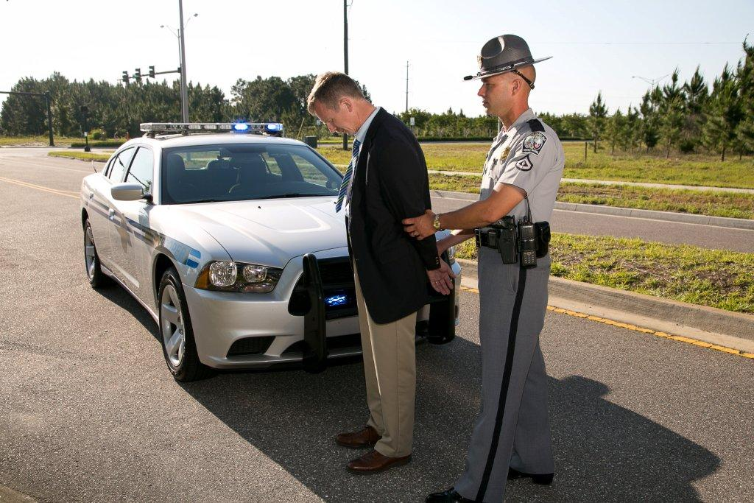
Processing Tasks

Slide 12
Essentials of Prosecution’s Case
Reasonable suspicion for contact
Probable cause for arrest
Proper arrest procedures
Post-arrest evidence
Request for chemical test(s)/results
Clear and concise report

Slide 13
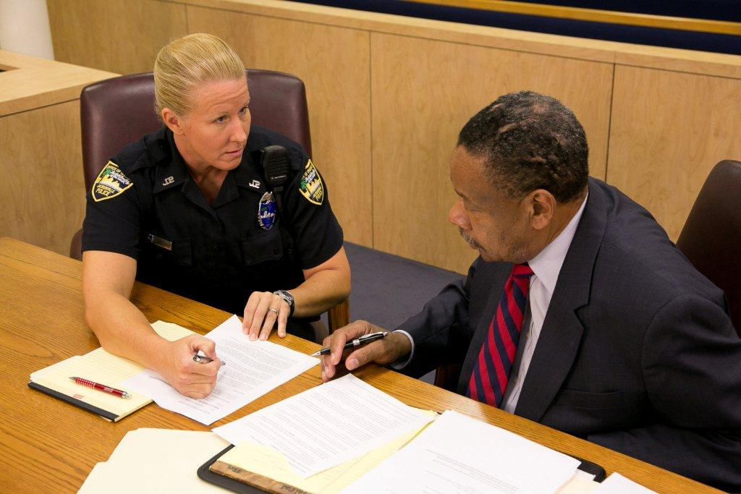
Detection and Arrest
Mentally note relevant facts
Field notes
Follow departmental policies

Slide 14
Writing the Report – Vehicle in Motion
Initial Observations
Driving or Actual Physical Control
Vehicle Stop

Slide 15
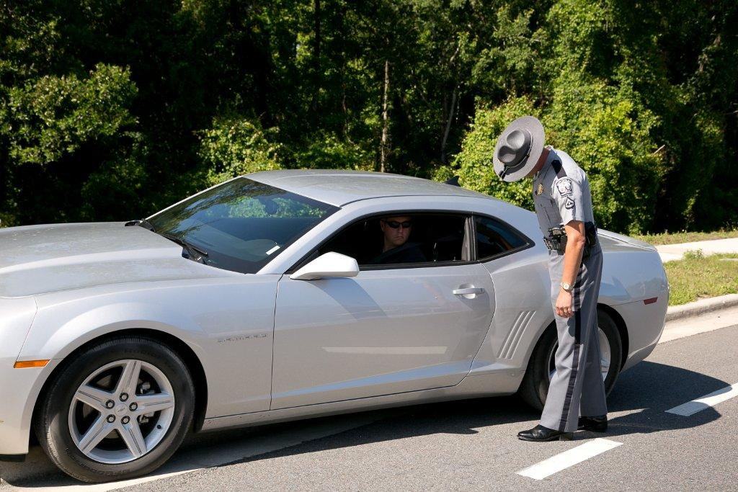
Writing the Report – Personal Contact
Contact With Driver
Preliminary Questions
Exit From Vehicle

Slide 16
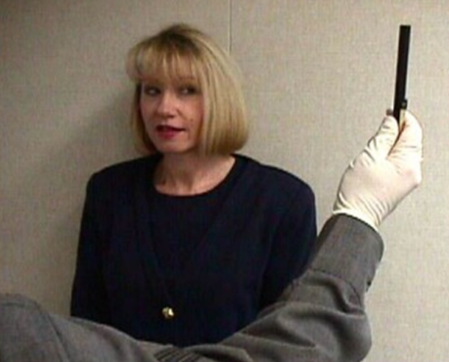
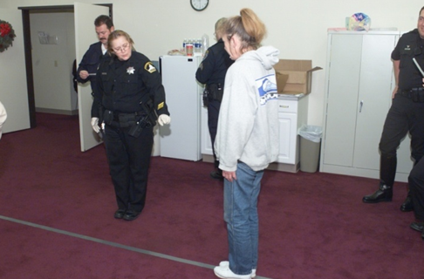
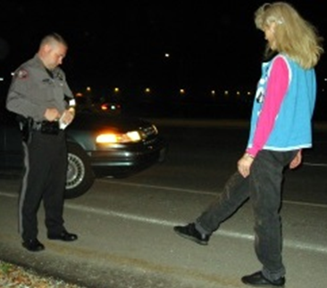
Writing the Report – Pre-Arrest Screening
SFSTs
Other Field Sobriety Tests
Arrest

Slide 17
Writing the Report – Post Arrest
ON SCENE:
Disposition of Passengers
Disposition of Vehicle and Property
Witness’ Statements
Transport of Defendant

Slide 18
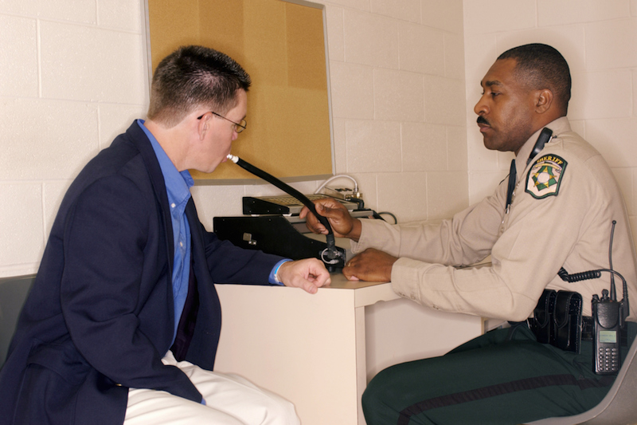
Writing the Report – Post Arrest
POST SCENE:
Implied Consent/Search Warrant
Evidentiary Test(s)
Miranda Warning
Citation/Complaint
Book or Release

Slide 19
Implied Consent
Document the implied consent advisement:
How did you explain the penalty for refusal?
What was the defendant’s response?
Did the defendant sign or refuse to sign the form?
Did the defendant explain his/her decision?
Did the defendant ask questions or acknowledge his/her understanding or lack of understanding of the penalty for refusal?
Did anyone witness the advisement?
Where and when was the advisement provided?

Slide 20
Search Warrant Procedure
Affidavit in Support Prepared
Search Warrant Issued
Service
Inventory and Return
Judgment on Search Warrant

Slide 21
What is a Search Warrant?
A search warrant is an ORDER in writing in the name of the state, signed by a magistrate or judge, directed to the sheriff, any constable, or any peace officer of the county, commanding the sheriff, constable or peace officer to search personal property for evidence of a crime, and bring the return before the magistrate.

Slide 22
Affidavit in Support of Issuance
A search warrant can only be issued on probable cause, supported by affidavit, naming or describing the person, and particularly describing the property, and the place to be searched.
To establish probable cause, an affidavit must set forth facts from which a reasonable conclusion may be drawn that the evidence will be found in the place for which the warrant authorizes a search. State v. Reid, 91 S.W.3d 247 (Tenn. 2002).

Slide 23
Affidavit Requirements
Examination under oath, reduced to writing, setting forth facts tending to establish the grounds of the application, or probable cause for believing the grounds exist. (Four Corners)
Observations, Training, Experience, Basis of Knowledge, Times and Dates. (Stale, Ripe, Probable Cause)
Hearsay can be used. (Totality of the Circumstances)

Slide 24
Who Can Issue a Search Warrant?
A magistrate or judge with jurisdiction in the county where the property sought is located may issue a search warrant authorized by this rule.
The judges of the supreme, appellate, chancery, circuit, general sessions, and juvenile courts have jurisdiction throughout the state; judicial commissioners and county executives only have jurisdiction in the officer’s respective counties, and are magistrates within the meaning of this title. T.C.A. § 40-1-106
If the warrant is for blood or drugs, include that the warrant is for obtaining and testing of the substances.

Slide 25
Service, Inventory, Return & Judgment
The warrant must be executed by the officer/officers to whom it is directed, that officer must be present and participate in the execution of the warrant, within 5 days of issuance, and a copy provided to the person whose property is searched or at the property searched with a receipt for items seized.
Officer executing must prepare an inventory and make a prompt return to the issuing magistrate.
The magistrate must transmit a copy of the inventory and return to the clerk’s office.
Magistrate issues a judgment regarding disposition of property seized.

Slide 26
Documenting Chemical Test
BREATH
Type and Location of Breath Instrument
Data-Identification of Result Entry Process
Observation Period (Location and Activities)
Instrument Working Properly
Defendant Supplying/Failed to Provide Sample
Result/Indication of Insufficient Sample

Slide 27
Documenting Chemical Test - Blood
Where was the blood drawn? By whom? Who was present at time of blood draw? Was a TBI kit used?
What was used to prepare the venipuncture site?
What was used to draw the blood and from what part of the body was the blood drawn? How many tubes of blood were drawn? Who labeled the tube(s)? Was the date and time placed on the tubes, if so, by whom? Were the tubes inverted to mix the blood with the anti-coagulant and preservative, if so, by whom? Who placed the tubes into the box? Who sealed the box?
Document procedure used to get this evidence to the evidence custodian. What is the agency policy to transport the blood to the laboratory?

Slide 28
Miranda Admonition
How was it provided?
Were their witnesses?
How many were present?
How was the waiver executed?
Who was present/witnessed the waiver?
Description of the location and the number of those present.

Slide 29
Citation/Complaint
T.C.A. Section 40-7-118
(b)(1) A peace officer who has arrested a person for the commission of a misdemeanor committed in the peace officer's presence, or who has taken custody of a person arrested by a private person for the commission of a misdemeanor, shall issue a citation to the arrested person to appear in court in lieu of the continued custody and the taking of the arrested person before a magistrate. If the peace officer is serving an arrest warrant or capias issued by a magistrate for the commission of a misdemeanor, it is in the discretion of the issuing magistrate whether the person is to be arrested and taken into custody or arrested and issued a citation in accordance with this section in lieu of continued custody. The warrant or capias shall specify the action to be taken by the serving peace officer who shall act accordingly.
(2)(A) This subsection (b) does not apply to an arrest for the offense of driving under the influence of an intoxicant as prohibited by § 55-10-401, unless the offender was admitted to a hospital, or detained for medical treatment for a period of at least three (3) hours, for injuries received in a driving under the influence incident.

Slide 30
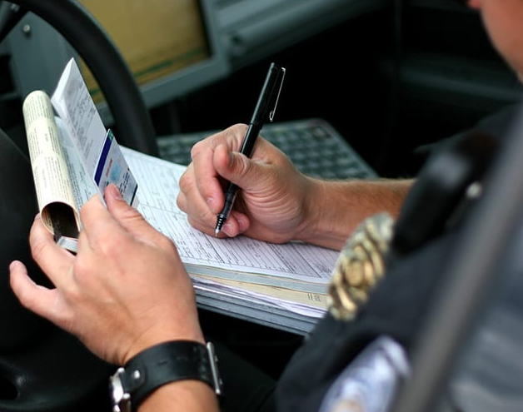
Writing the Report
Narrative must be detailed and accurate
Successful prosecution depends on your ability to describe events observed

Slide 31
Nighttime DWI Arrest

Slide 32
DWI Incident Report
Defendant: Jarod Primo Age:31
Date of Arrest: XX/XX/XX
Time of Arrest: 9:20 PM
Initial Observation:
Defendant driving white SUV
Driving without license plate
Drifted over the center line twice

Slide 33
DWI Incident Report
Initial Observation:
Weaving within lane
Four lane roadway, clear, breezy, traffic light
Slow response to stop command
Crossed over fog line
Failed to use turn signal
Failed to stop at stop sign

Slide 34
DWI Incident Report
Contact with Driver
Driver was sole occupant
Produced credit card instead of DL
Forgot to produce registration/insurance
Odor of alcoholic beverage in vehicle
Admissions of drinking
Unsteady on exit from vehicle

Slide 35
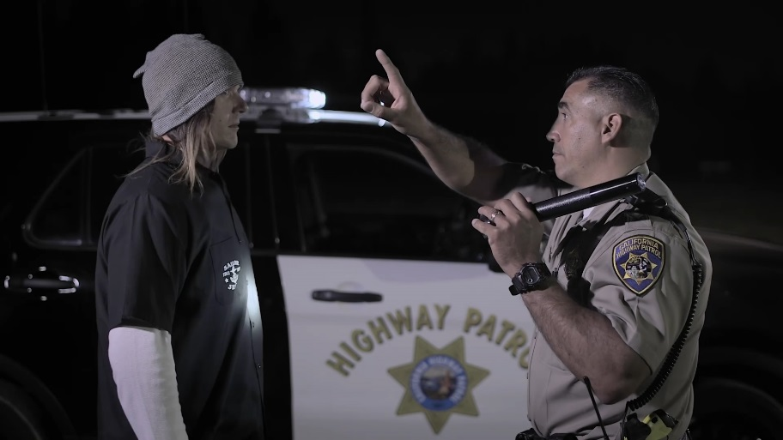
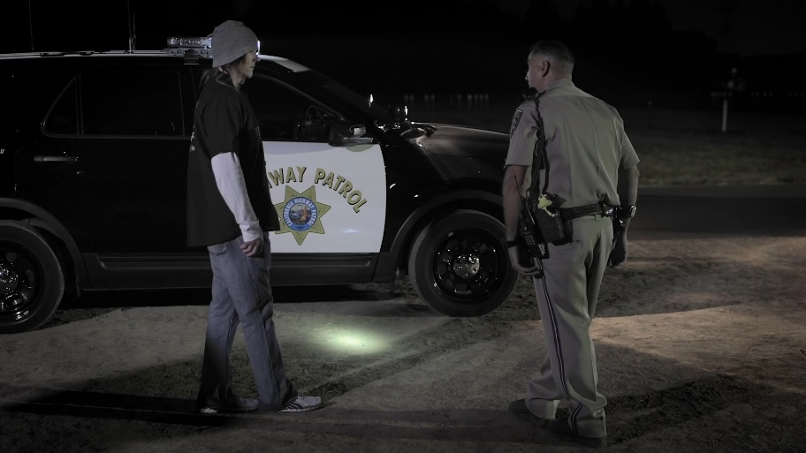
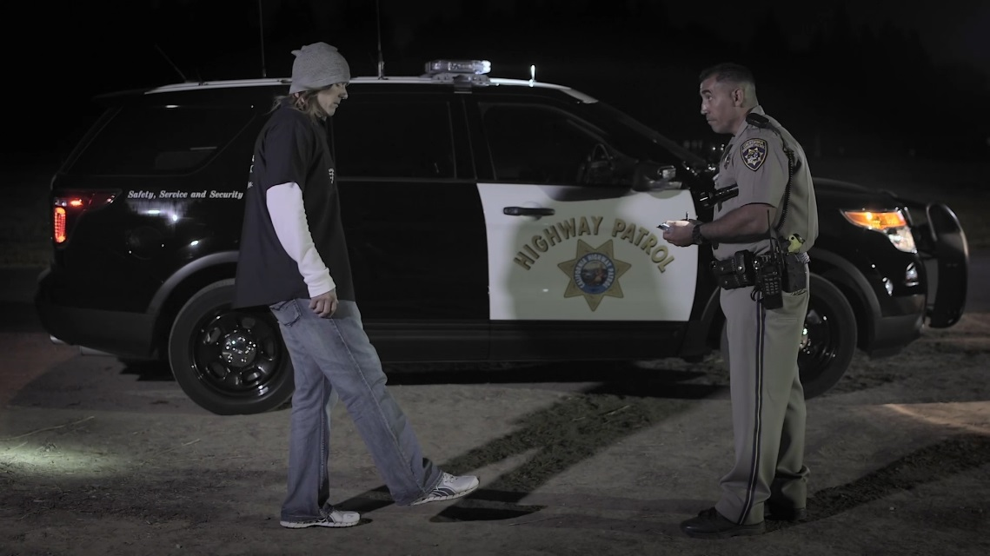
SFSTs

Slide 36
The Arrest
Based on observations of defendant’s driving, physical appearance, and performance of SFSTs, the defendant was placed under arrest for DUI.

Slide 37
Case Preparation
Use field notes to document evidence
Accurately note statements and other observations
Review case with other officers
Collect and preserve evidence
Prepare required documents

Slide 38
Report Consistency
Adequately and effectively explain the inconsistencies
Review records and reports
Properly document evidence

Slide 39
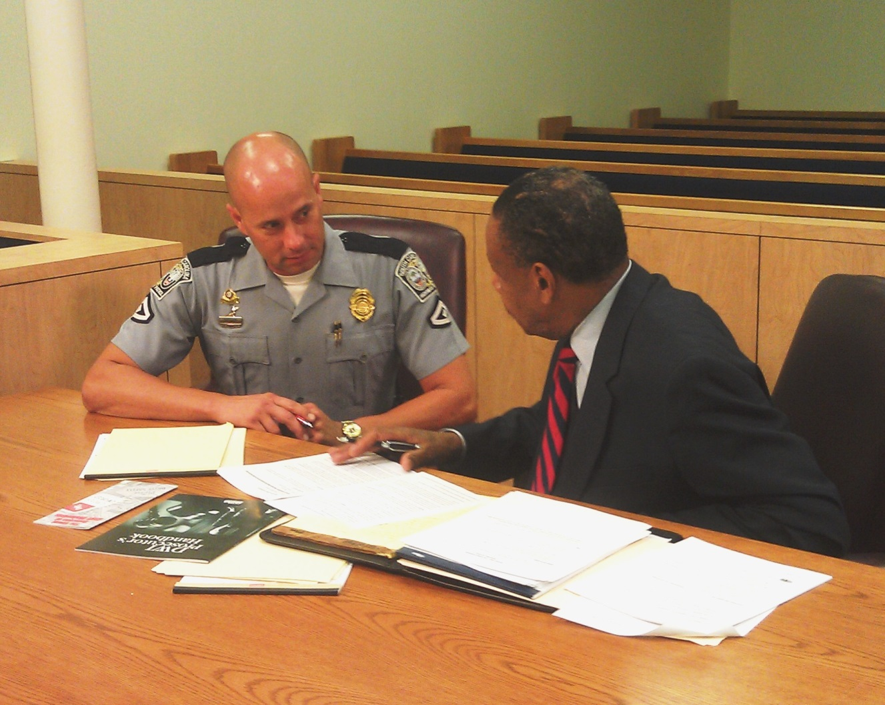
Pretrial Conference

Slide 40
Pretrial Conference
Be prepared
Discuss all evidence/conclusions
Identify strengths and issues
Review potential questions
Identify defense challenges

Slide 41
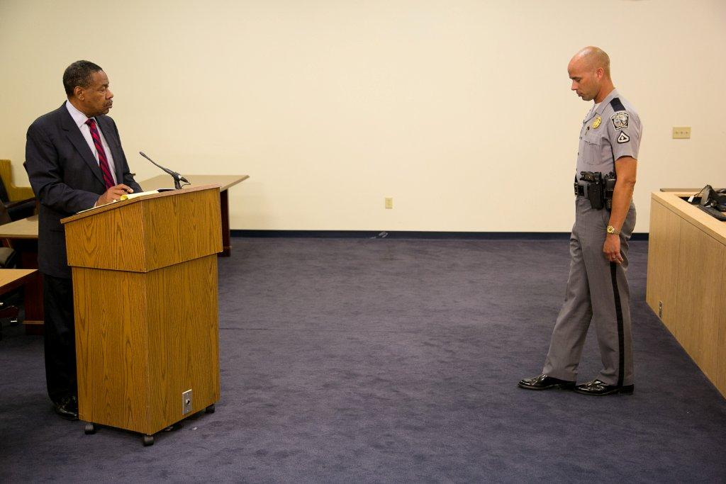
Direct Testimony
Describe in detail case facts, all observations, SFSTs clues/observations
Be professional
Be truthful
Use plain language
Make eye contact with judge/jury
Repeat important points

Slide 42
Cross Examination
Be polite
Don’t become agitated
Answer only the question asked. If you don’t understand the question, asked that it be repeated or rephrased. Don't answer a poorly asked question.
If you don’t know the answer
Don’t guess
“I don’t know” “I don’t recall” “I don’t remember”

Slide 43
Defense Challenges
Your observations/interpretations
Your credentials

Slide 44
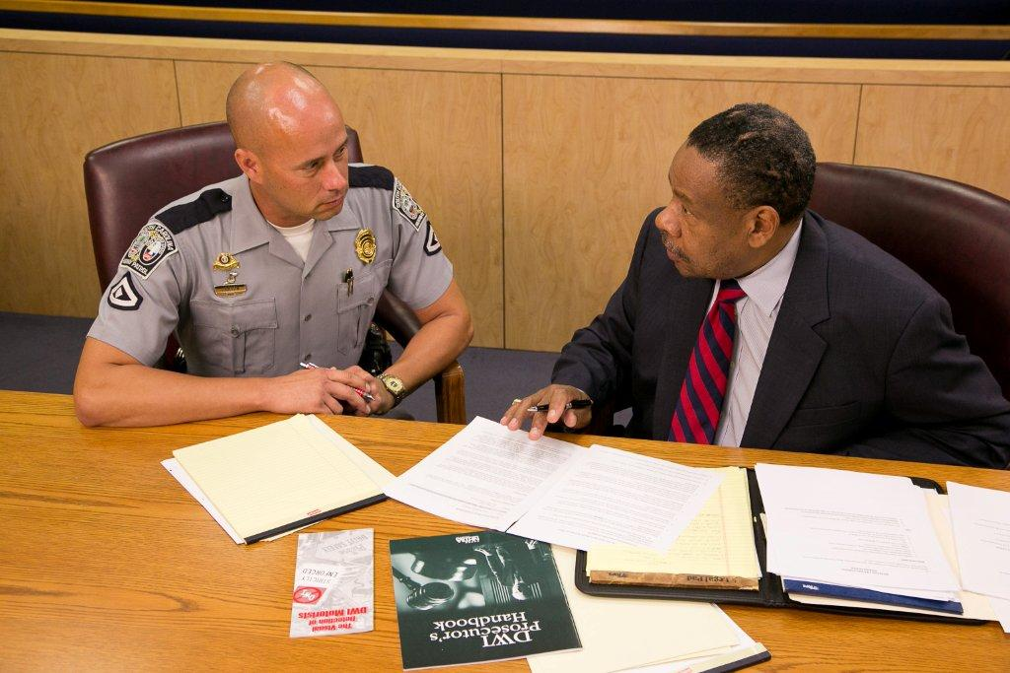
Defense Challenges
Your credibility
Your competency
SFSTs

Slide 45
Remember
Time spent conducting a complete and thorough investigation, documenting the investigation, and documenting each step of the arrest process will ultimately save you time later in court.

Slide 46
Questions?
Contact Tennessee’s Traffic Safety Resource Prosecutors
Go to
dui.tndagc.org
for
Contact Information

